Slide 1

Page 01
Car Service Transaction Data
Name : Dalia Nasser Mohamed - Yousef Mahmoud Ali
Group : ML_Group2
Task No.: 5th Task
Read More

Slide 2
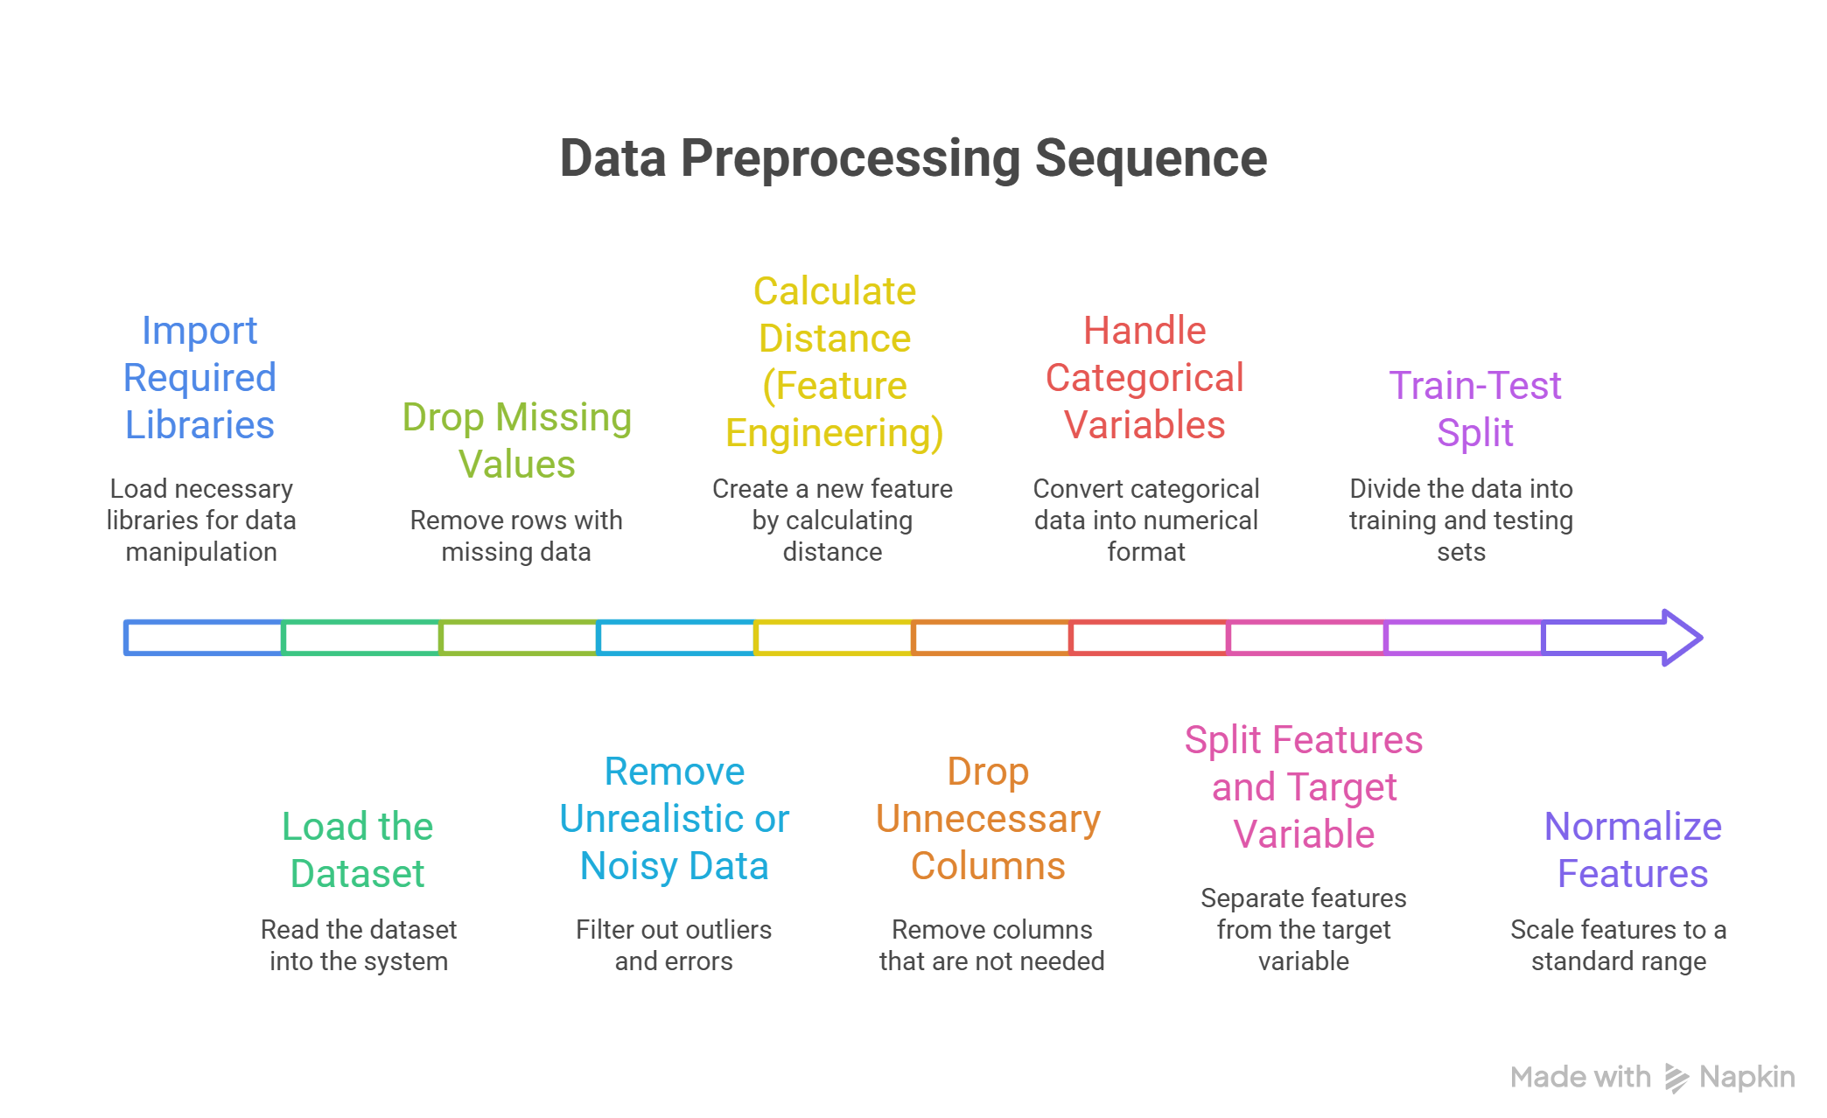


Data Preprocessing & Feature Engineering
Page 02
Preprocessing ensures data quality by removing outliers, handling missing values, encoding categories, and engineering key features like trip distance — all critical for accurate fare prediction.

Slide 3
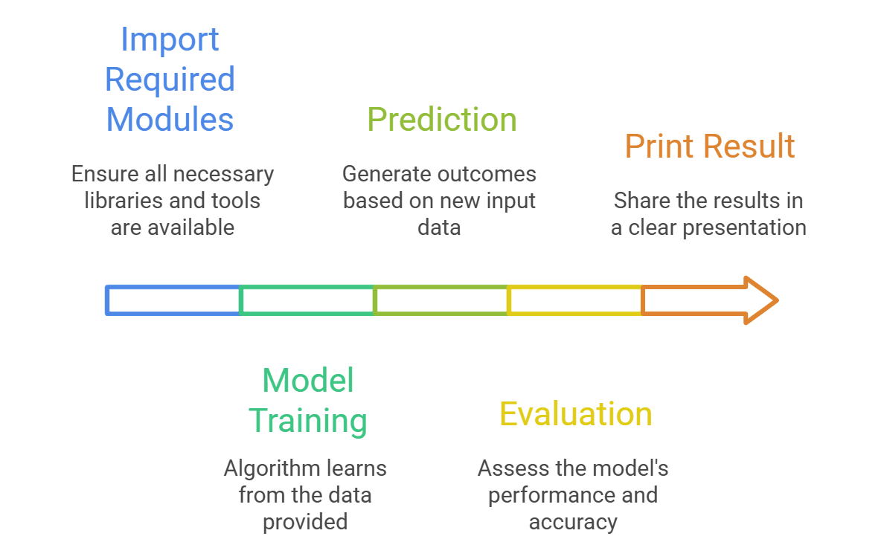

Decision Tree Regression & Performance Evaluation
Page 04
The Decision Tree model captures complex, non-linear fare patterns that linear models may miss — often improving accuracy, though at the risk of overfitting. The accuracy is 63.8%.

Slide 4
Gradient Boosting Regressor for Enhanced Prediction
Page 04
Gradient Boosting intelligently combines multiple shallow trees to capture complex patterns, often outperforming simpler models while maintaining generalization. The accuracy is 74.15%

Slide 5
XGBoost Regression - Fast & Powerful
Ensemble Model
Page 04
XGBoost leverages gradient boosting with powerful optimizations, making it a top choice for structured data regression with high accuracy and speed. The accuracy is 73.6%.

Slide 6
LightGBM Regression — Lightweight, Fast & Accurate
Page 04
LightGBM combines speed and scalability with gradient boosting power, making it ideal for large-scale regression tasks with high prediction accuracy. The accuracy is 78.41%.

Slide 7
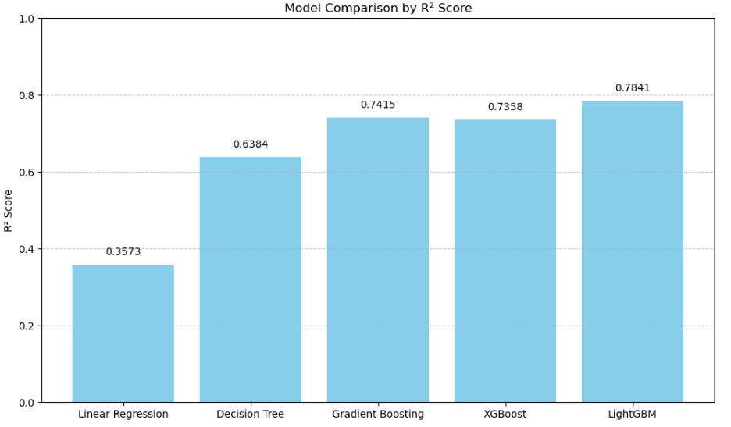
Model Comparison
Page 04

Slide 8
After Tuning - Hyperparameters
Page 05
Hyperparameter Tuning for Decision Tree using GridSearchCV:
GridSearchCV fine-tunes the Decision Tree model by exploring parameter combinations, improving performance and reducing the risk of overfitting or underfitting.
The accuracy reached to 79.13%.
LightGBM Hyperparameter Tuning using RandomizedSearchCV:
RandomizedSearchCV efficiently fine-tunes LightGBM by testing random parameter combinations, balancing speed and performance to find a high-scoring model.
The accuracy reached to 75.3%.

Slide 9
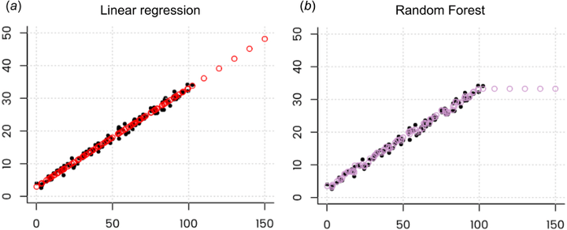

More Models Applied for Fare Prediction
Page 06
To predict the fare amount based on various features like distance, weather, and time, applied two different regression models: Linear Regression and Random Forest.
Linear Regression: Simple and interpretable baseline model to establish a relationship between features and target.
Random Forest: Ensemble model that leverages multiple decision trees to capture more complex, non-linear relationships.

Slide 10

Random Forest
Page 07
Choice: Random Forest is an ensemble learning technique that uses multiple decision trees.
Advantage: It can solve complex non-linear relationships in the data, which a linear model might miss.
Training: Model trained on the same features used for Linear Regression.
Performance:
#First try: 82.60%, 100 , 5 , 30
#Second try: 85.63%, 150 , 15 , 40
#Third try: 85.73%, 250 , 20 , 40
#Fourth try: 85.71%, 350 , 40 , 40
Amazing service and super easy process!
"Found the perfect car with zero hassle."
<
>
Morgan Maxwell
Neil Tran

Slide 11
Hyperparameter Tuning - Random Forest
Page 07
Hyperparameter tuning is the process of finding the optimal settings for the parameters of a machine learning model to improve its performance. Experiments Conducted:
First Try: n_estimators = 100, max_depth = 5, random_state = 30 → Accuracy: 82.60%
Second Try: n_estimators = 150, max_depth = 15, random_state = 40 → Accuracy: 85.63%
Third Try: n_estimators = 250, max_depth = 20, random_state = 40 → Accuracy: 85.73%
Fourth Try: n_estimators = 350, max_depth = 40, random_state = 40 → Accuracy: 85.71%
Conclusion:
Through manual tuning, the optimal combination was found to be 250 trees with a depth of 20 and random state of 40, resulting in the highest accuracy of 85.73%.
Amazing service and super easy process!
"Found the perfect car with zero hassle."
<
>
Morgan Maxwell
Neil Tran

Slide 12
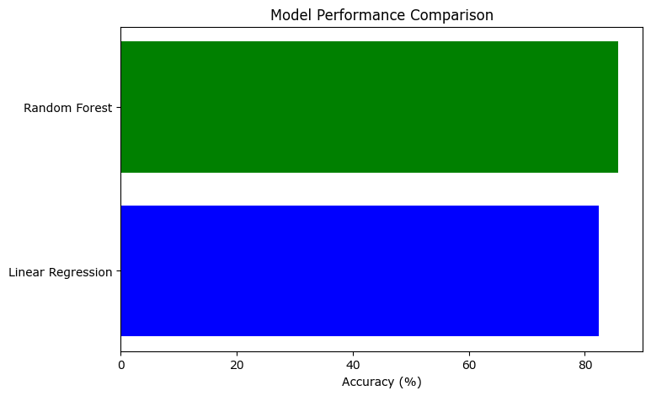
Model Performance Comparison
Page 08
Linear Regression:
Accuracy: 82.36%
MAE: 1.46
Simple along with meaning.
Random Forest:
Accuracy: 85.73%
Stronger performance in capturing complex patterns.

Slide 13

Page 10
+123-456-789 - hello@reallygreatsite.com

